Slide 1
Cycle 1 Data Flow Diagram
Diagram 1
8.01 Managing Vendors/Suppliers
8.02 Creating Item/Product Catalog
9.01 Capturing and Analyzing Receipts
9.04 Consolidate Payments
Diagram 2
9.04 Consolidate Payments
10.01 Creating Bill
10.04 Automating Recurring Bills
11.02 Oversee Supplier & Cost Management
11.05 Handle Payment Processing

Slide 2
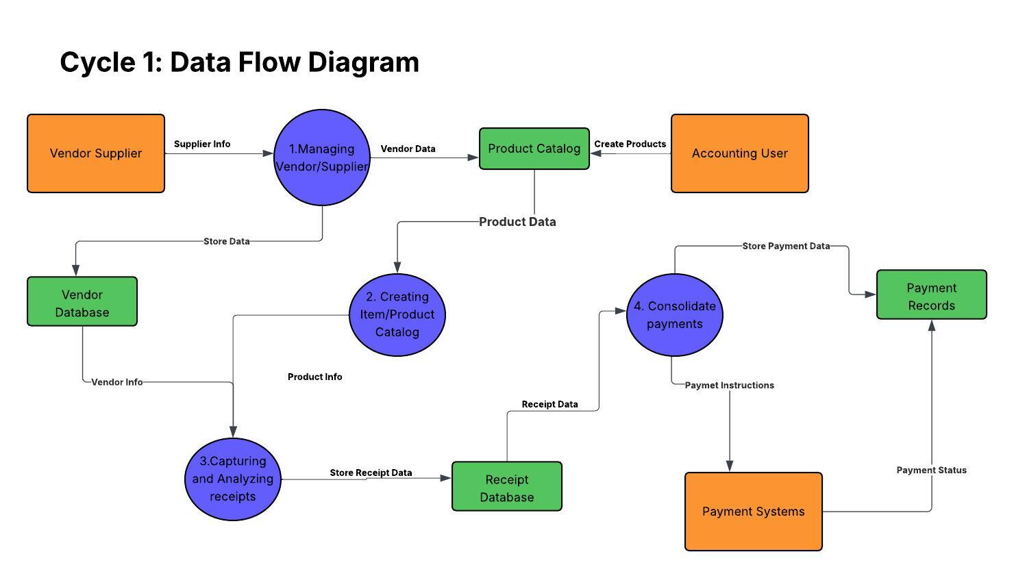

Slide 3
